Slide 1
Chongqing University of Technology
ATAI
Advanced Technique of Artificial Intelligence
Chongqing University of Technology
Aspect Sentiment Classification with Document-level Sentiment Preference Modeling（ACL 2020 ）
彭展望
Code:暂无

Slide 2
Outline
Introduction
Related Work
Method
Experiment
Conclusion

Slide 3
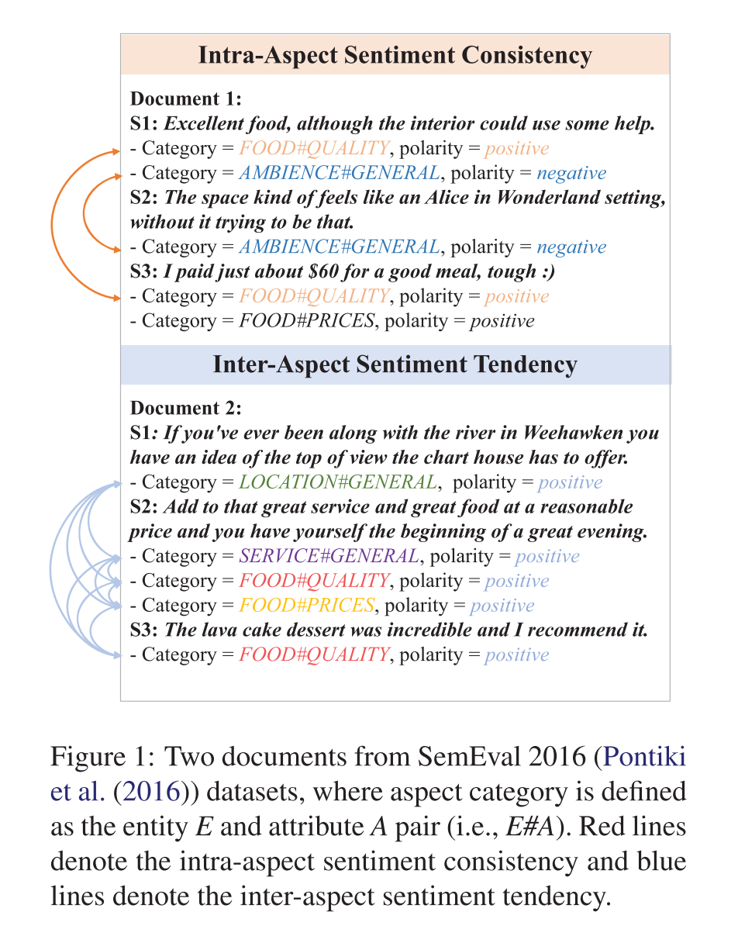
Introduction
Notes:
很棒的食物，虽然内部需要一些帮助。这个空间感觉有点像《爱丽丝梦游仙境》中的场景，但它并不是这样的。如果你曾经去过威霍肯的河流，你就会知道图屋提供的顶部视图。再加上优质的服务和价格合理的美食，你就有了一个美好夜晚的开始。熔岩蛋糕甜点非常棒，我推荐它。

Slide 4
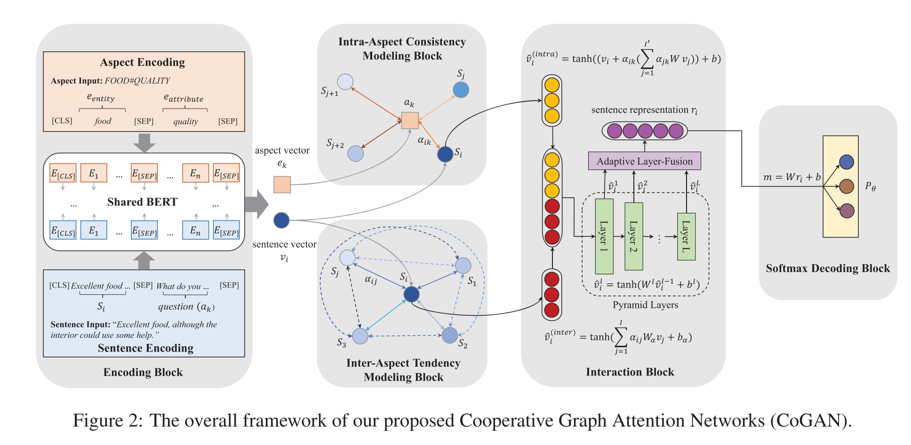
Method

Slide 5
Method
$$D is document$$
$$S_{i} is the i−th sentence$$
$$a_{k} is the k−th aspect$$
$$question\left(a_{k}\right):$$
Notes:
$$question\left(a_{k}\right):$$

Slide 6
Method
f(·) is a LeakyReLU activation function

Slide 7
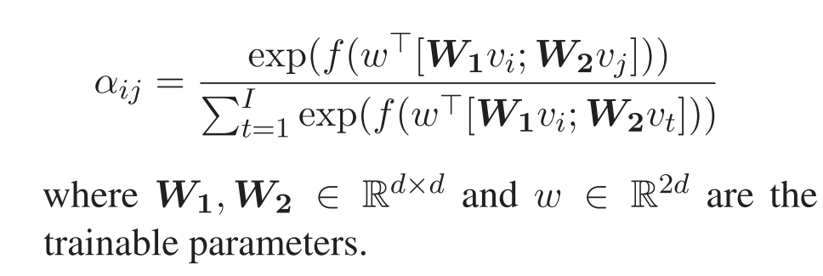
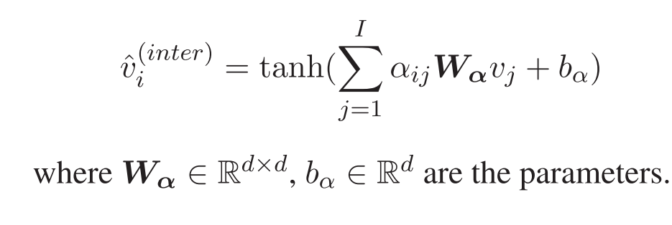
Method
f(·) is a LeakyReLU activation function

Slide 8
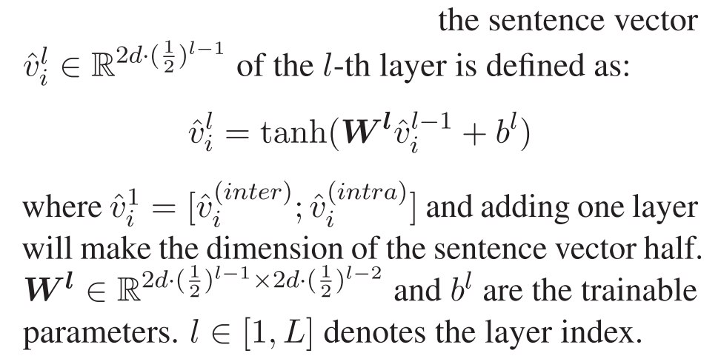
Method

Slide 9
Method

Slide 10
Dataset

Slide 11
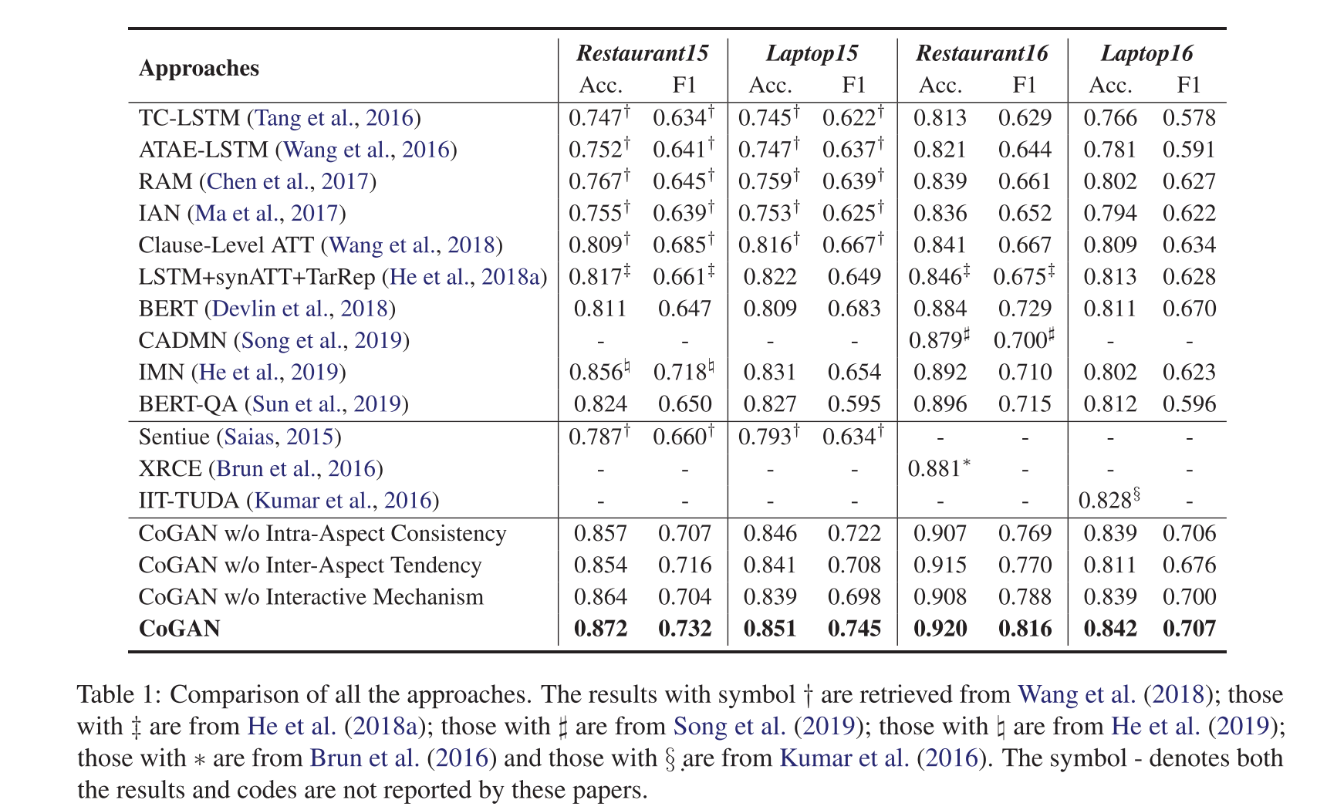
Experiment

Slide 12
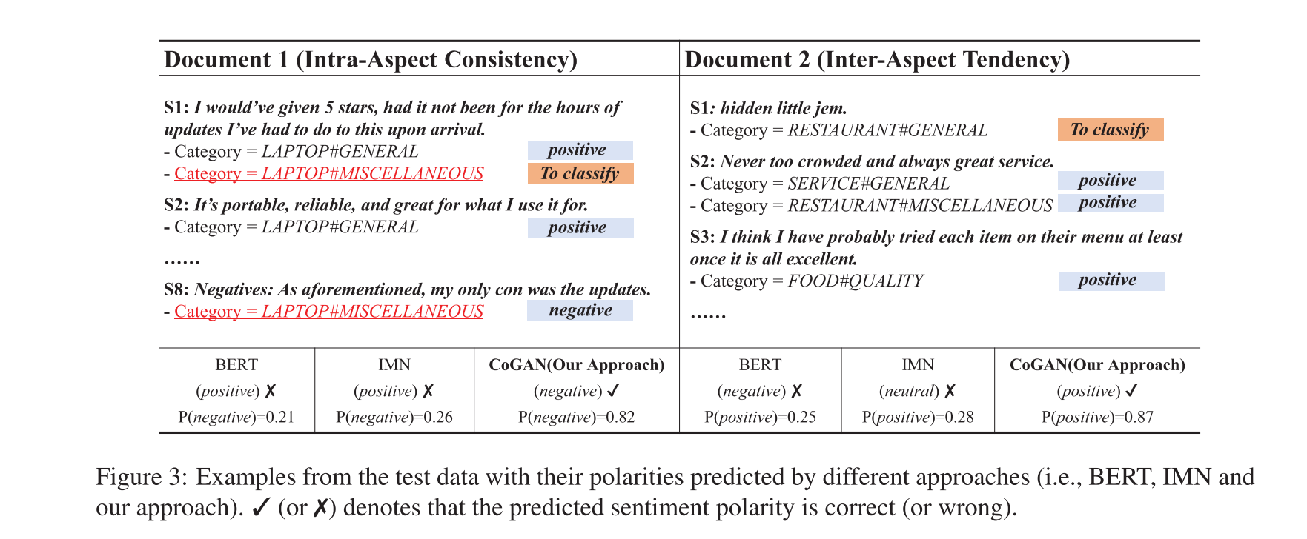
Experiment

Slide 13
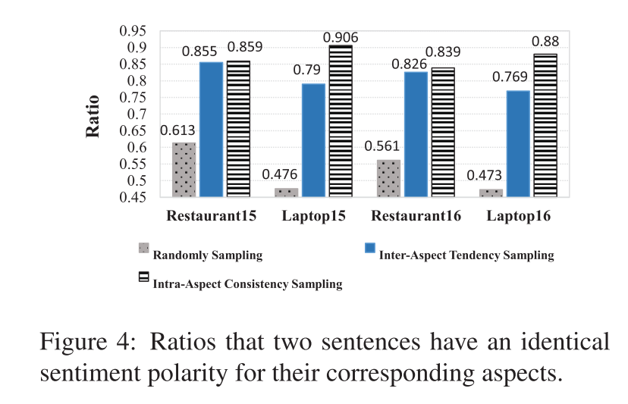
Experiment

Slide 14
Thanks

